Slide 1


CPU Design and Verification
: Vehicle Application
발표자: 김지환
팀원: 김태민, 박지수, 함영은

Slide 2
01.
Introduction
Contents
02.
ABP BUS Specification
03.
Peripherals
04.
Conclusion

Slide 3
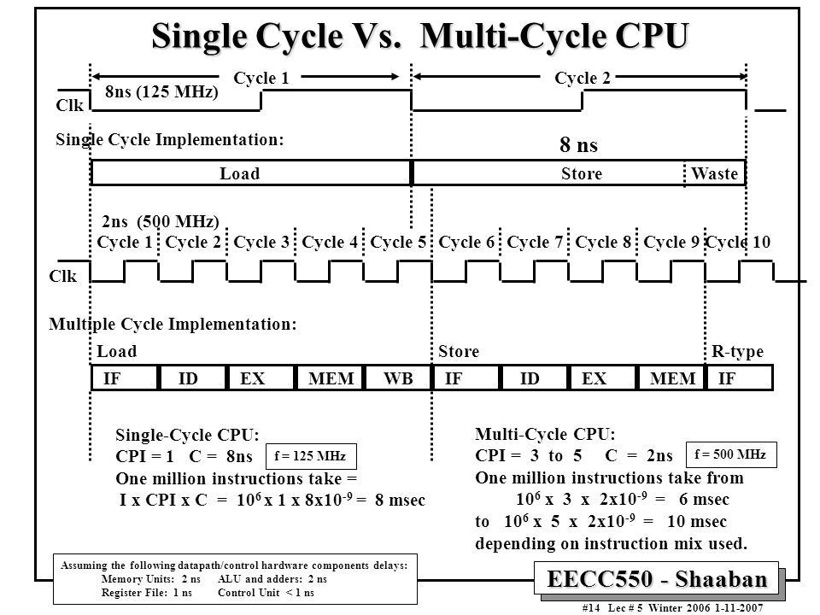
01. Introduction
Notes:
저번에 설계했던 싱글 사이클 CPU를 멀티 사이클 CPU로 업그레이드 시켰음
이렇게 함으로써 우리는 각 명령어마다 각기 다른 처리 속도를 가지는데
낭비를 최소한으로 하는 조금 더 성능이 좋은 CPU로 만들었음

Slide 4
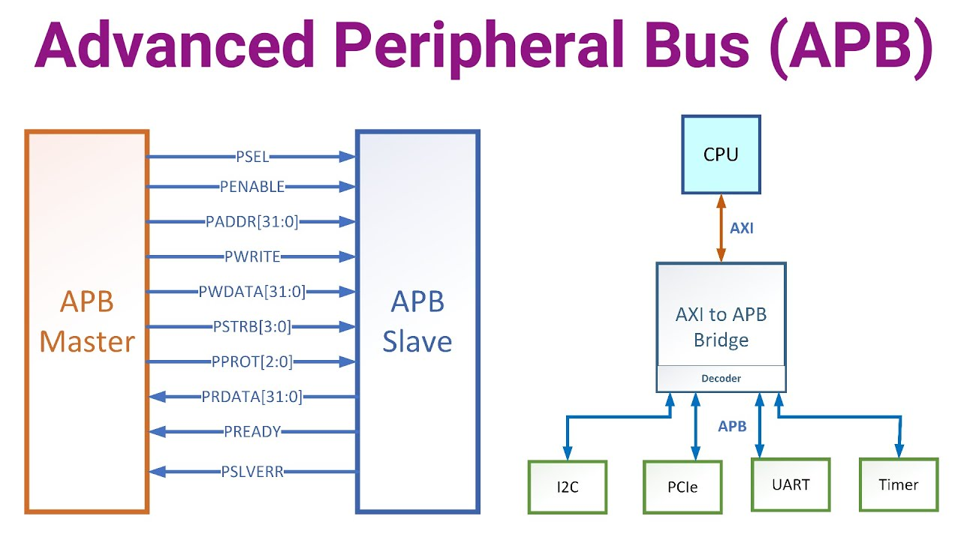
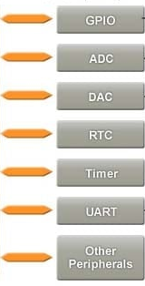

01. Introduction
Project Goal

Slide 5
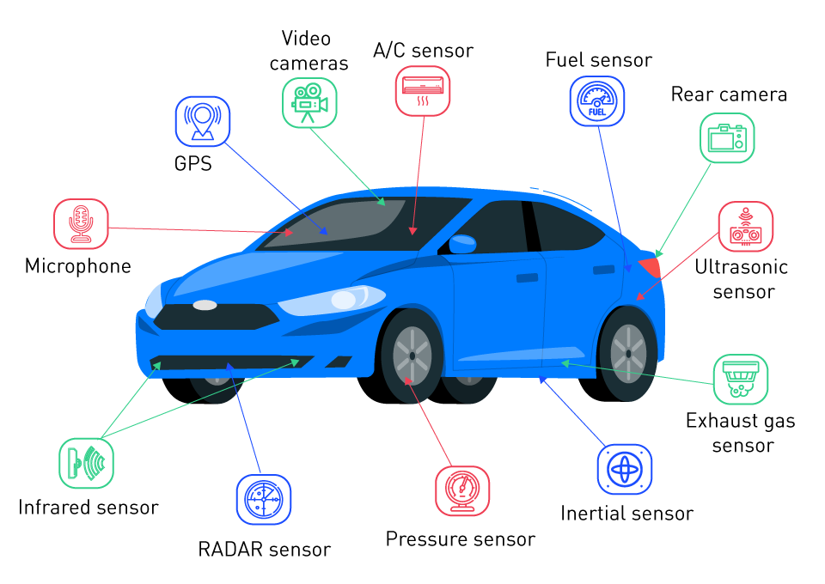
01. Introduction
Project Goal

Slide 6
01. Introduction
Main Contents

Slide 7


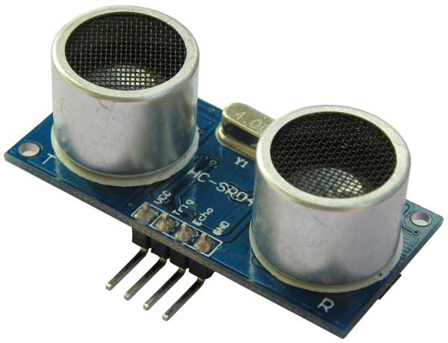
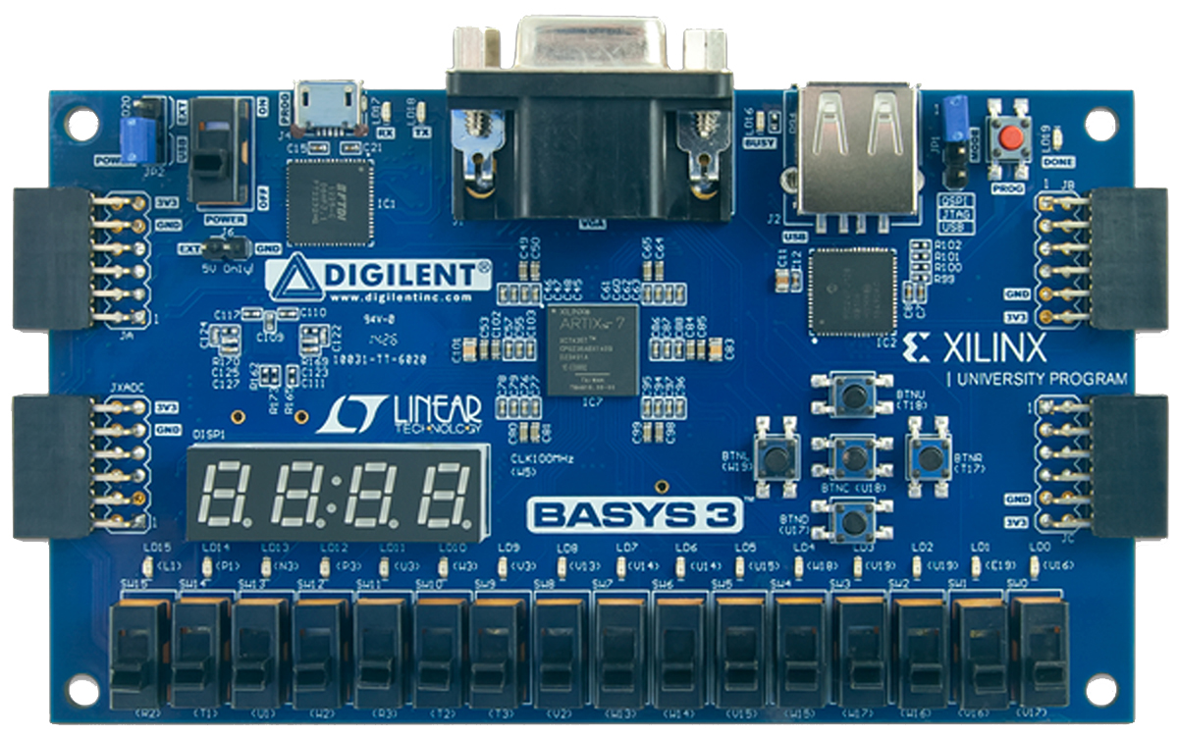
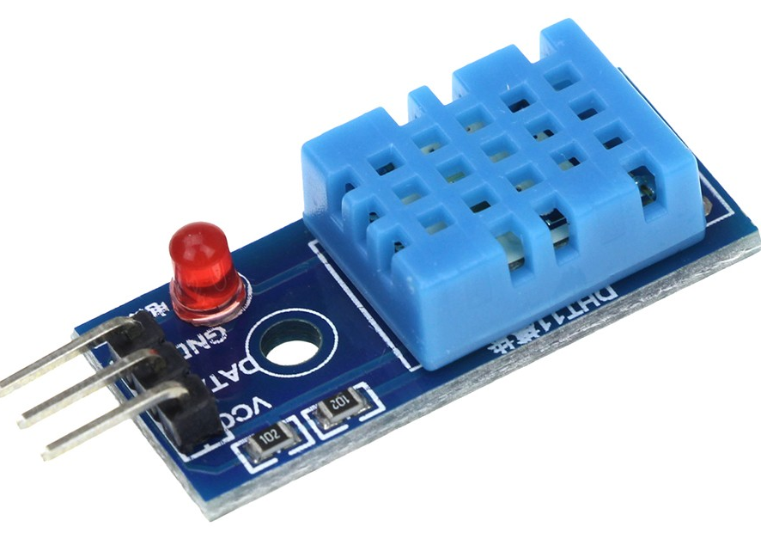
01. Introduction

Slide 8

02. APB Bus Specification

Slide 9
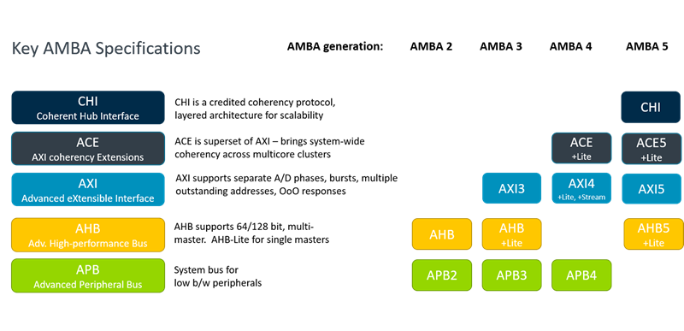
02. APB Bus Specification

Slide 10
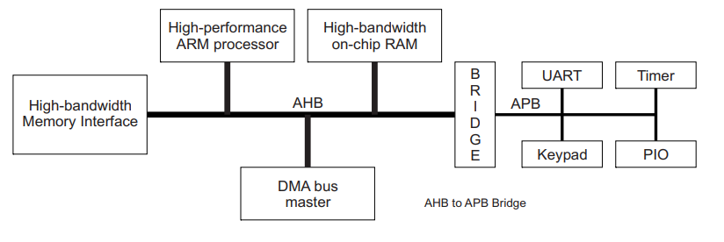
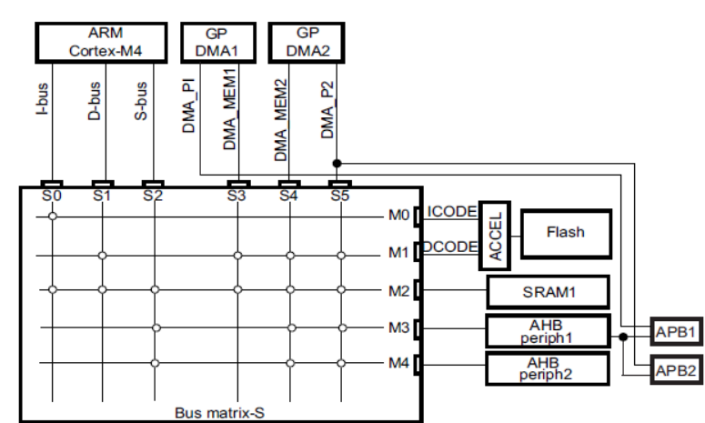
02. APB Bus Specification

Slide 11
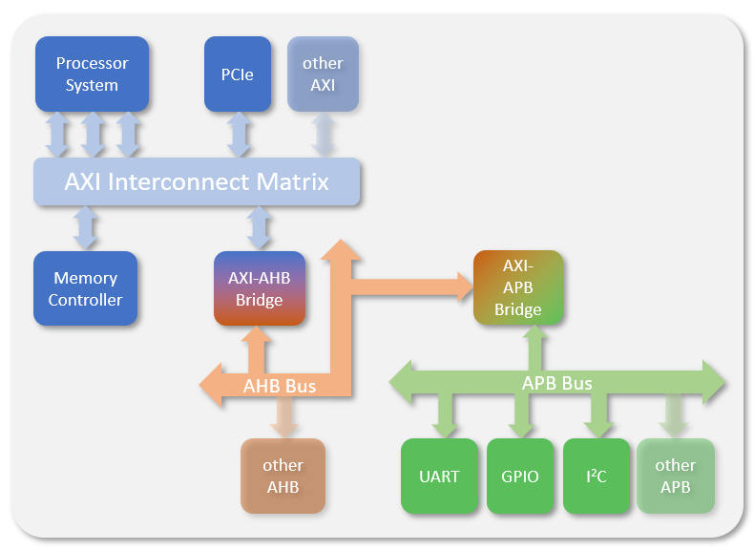
02. APB Bus Specification

Slide 12
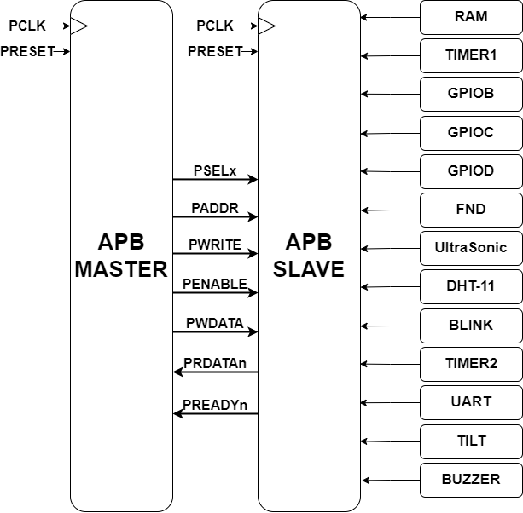
02. APB Bus Specification

Slide 13
02. APB Bus Specification
Bus | Boundary address | Peripheral
APB | 0x1000 4000 ~ 0x1000 43FF | BUZZER
 | 0x1000 3C00 ~ 0x1000 3FFF | NOTHING
 | 0x1000 3800 ~ 0x1000 3BFF | TILT
 | 0x1000 3400 ~ 0x1000 37FF | UART
 | 0x1000 3000 ~ 0x1000 33FF | TIMER2
 | 0x1000 2C00 ~ 0x1000 2FFF | BLINK
 | 0x1000 2800 ~ 0x1000 2BFF | DHT-11
 | 0x1000 2400 ~ 0x1000 27FF | ULTRASONIC
 | 0x1000 2000 ~ 0x1000 23FF | FND
 | 0x1000 1C00 ~ 0x1000 1FFF | GPIOC
 | 0x1000 1800 ~ 0x1000 1BFF | GPIOB
 | 0x1000 1400 ~ 0x1000 17FF | GPIOA
 | 0x1000 1000 ~ 0x1000 13FF | TIMER1
 | 0x1000 0000 ~ 0x1000 0FFF | RAM
Notes:
페리페럴 설명, 시뮬레이션 결과, C 코드로 동작 시키는 거 리뷰, 동작 영상

Slide 14
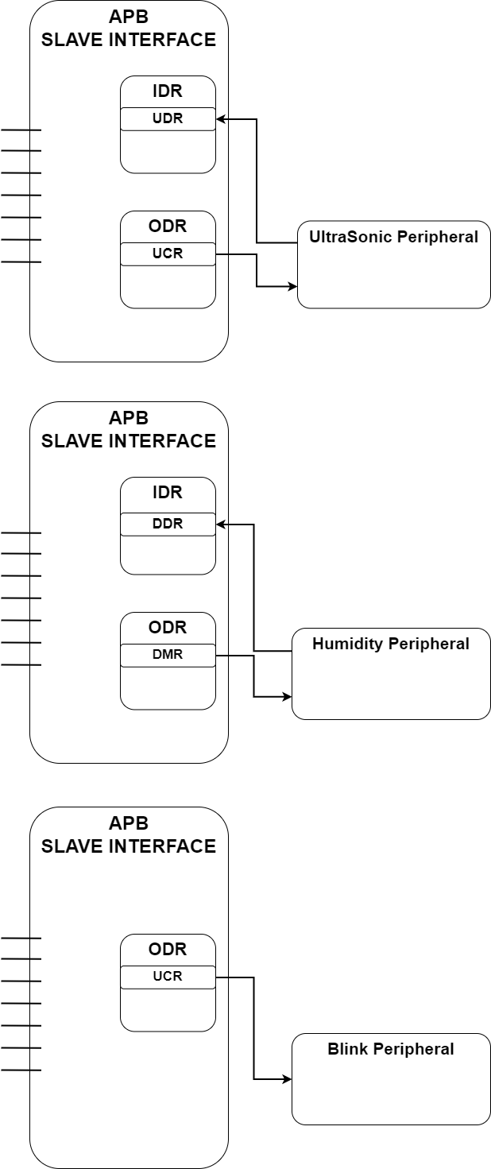
03. Peripherals - UltraSonic
Name | Type | Offset | Description
UCR | Output / Control Signal | 0x00 | 0 : wait 1 : start
UDR | Input / Data | 0x04 | Distance value (unit : cm)

Slide 15
03. Peripherals - UltraSonic

Slide 16
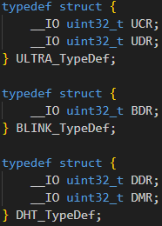


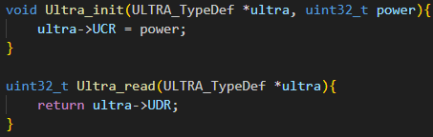
03. Peripherals - UltraSonic
definition

Slide 17
03. Peripherals - Humidity
Name | Type | Offset | Description
DDR | Input / Data | 0x00 | Value
DMR | Output / Select Signal | 0x04 | 0 : Temperature 1 : Humidity

Slide 18
03. Peripherals - Humidity

Slide 19
03. Peripherals - Humidity

Slide 20

03. Peripherals - Blink
Name | Type | Offset | Description
BDR | Output / Control Signal | 0x00 | Blink cycle

Slide 21
03. Peripherals - Blink

Slide 22
03. Peripherals - Blink

Slide 23
03. Waveform by type

Slide 24
03. Waveform by type
R-Type

Slide 25
03. Waveform by type
R-Type

Slide 26
03. Waveform by type
R-Type

Slide 27
03. Waveform by type
L-Type

Slide 28
03. Waveform by type
L-Type

Slide 29
03. Waveform by type
I-Type

Slide 30
03. Waveform by type
I-Type

Slide 31
03. Waveform by type
S-Type

Slide 32
03. Waveform by type
S-Type

Slide 33
03. Waveform by type
B-Type

Slide 34
03. Waveform by type
B-Type

Slide 35
03. Waveform by type
LU-Type

Slide 36
03. Waveform by type
AU-Type

Slide 37
03. Waveform by type
J, JL-Type

Slide 38
03. Waveform by type
U, J-Type

Slide 39
04. Conclusion
Notes:
향후 개선 방향(예: 인터페이스 개선, 추가 기능 확장)

Slide 40
Thank you

